Slide 1

Annual Performance Review Meeting (APRM)

Slide 2

How did we do in these years ?
Who buys more in each year ?
AGENDA
APRM YEAR
2017
to
2018
Each year so far…
What are our top selling products ?
What Next ?

Slide 3



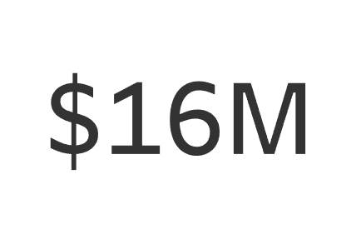
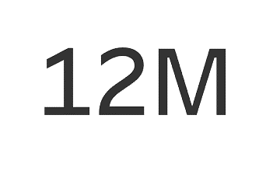
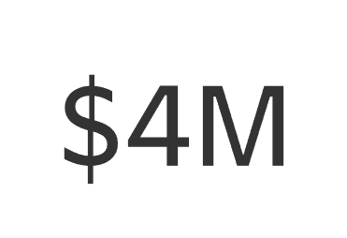
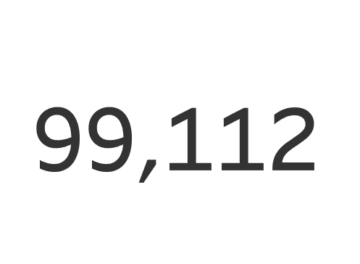
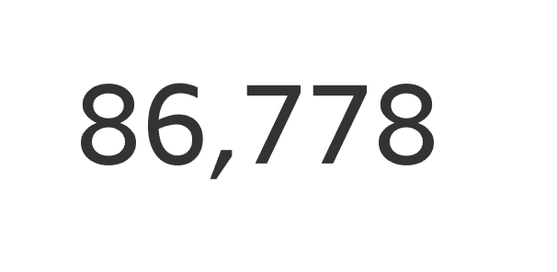
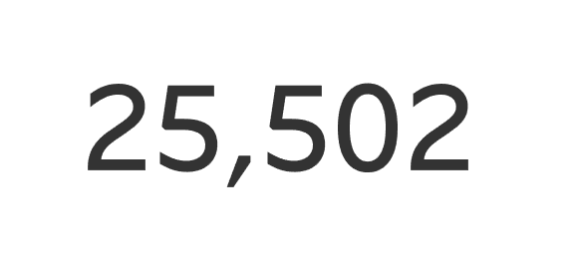

APRM YEAR
2017
to
2018
Total Revenue
Weekday Revenue
Weekend Revenue
How did we do in these years ?
Total Orders
weekday Orders
weekend Orders

Slide 4
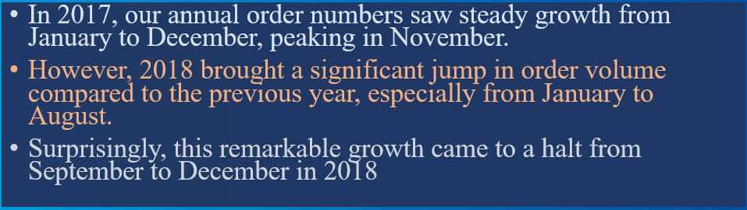
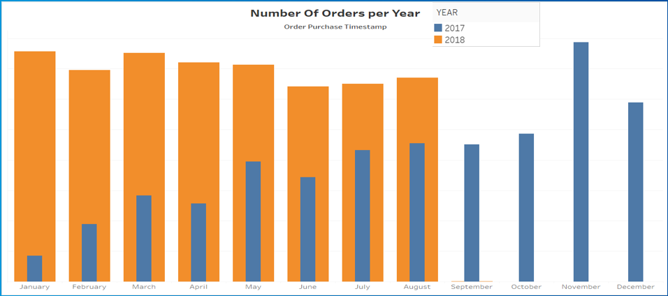
Number Of Orders per Year
APRM YEAR
2017
to
2018
Each year so far

Slide 5
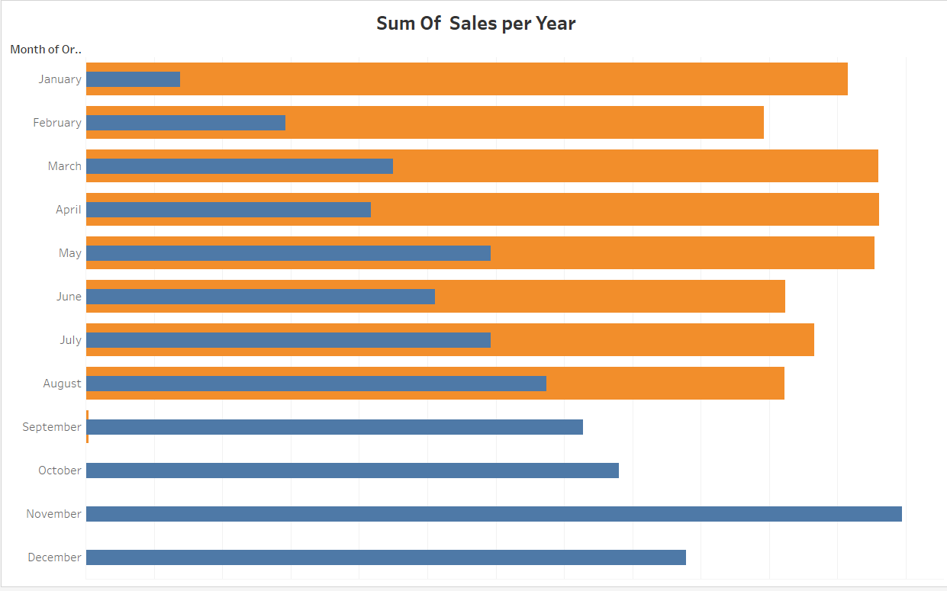

Sum Of Sales per Year
Each year so far
In 2017, our annual sales exhibited consistent growth, steadily increasing from January through December, with the highest peak achieved in November.
However, 2018 brought a remarkable surge in sales compared to the previous year, particularly from January to August.
Unfortunately, their growth stalled from September to December in 2018. The decline in sales during this period is directly related to the significant decline in the number of orders.

Slide 6

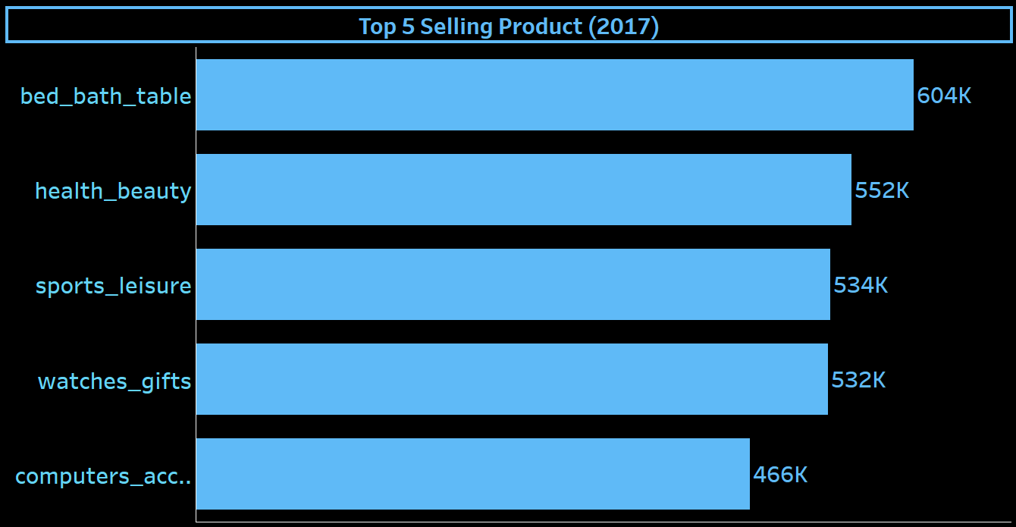
What are our top selling products ?
"In the fiscal year of 2017, our company's top-performing products were as follows: Bed Bath Table generated sales of 604k , closely followed by Health Beauty at 552k, and Sport Leisure at 534k. Watches Gifts remarkably reached 532k, and Computer Accessories concluded the top five with 466k sold. This data is visually represented in the accompanying bar chart, illustrating the sales performance of our top five products."

Slide 7
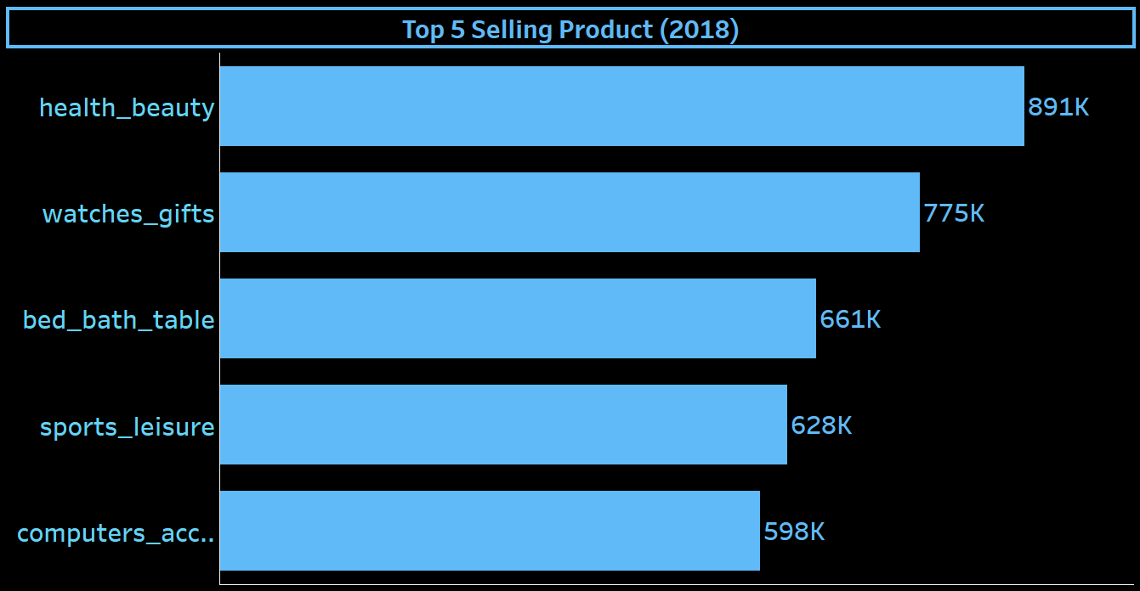
What are our top selling products ?
"In 2018, our leading product categories demonstrated exceptional performance. Health and beauty emerged as the top performer, generating 891k in sales, followed closely by watches and gifts with 775k, bed, bath, and tables at 661k, sport leisure at 628k, and finally, computer accessories at 598k. These figures, highlighted in the bar chart, underscore the top five products contributing significantly to our overall sales performance."

Slide 8

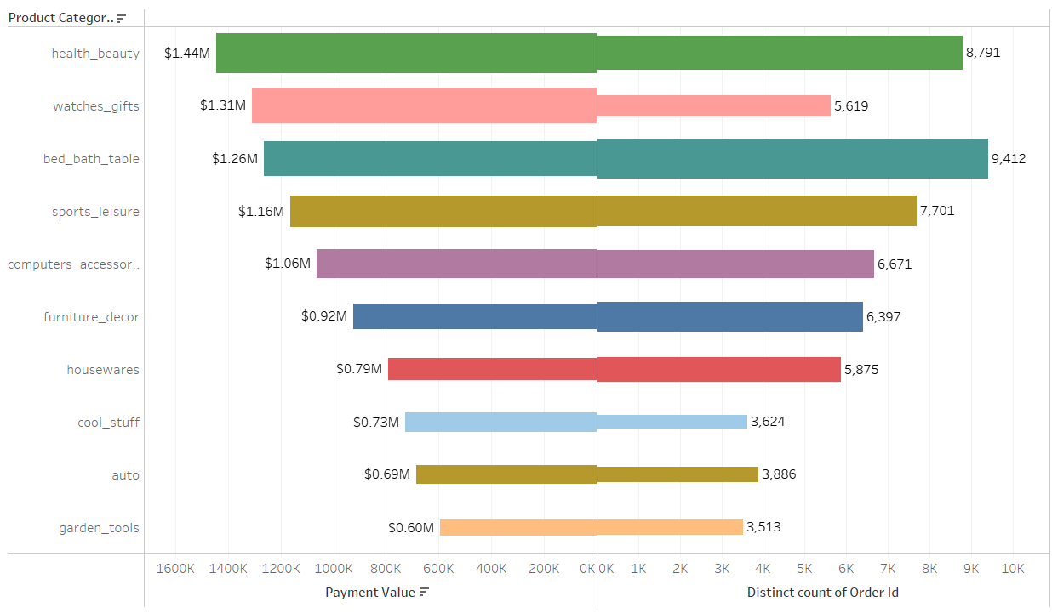
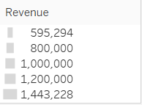
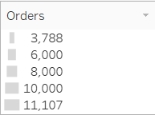
Product behaviour by revenue v/s orders 2017-2018

Slide 9
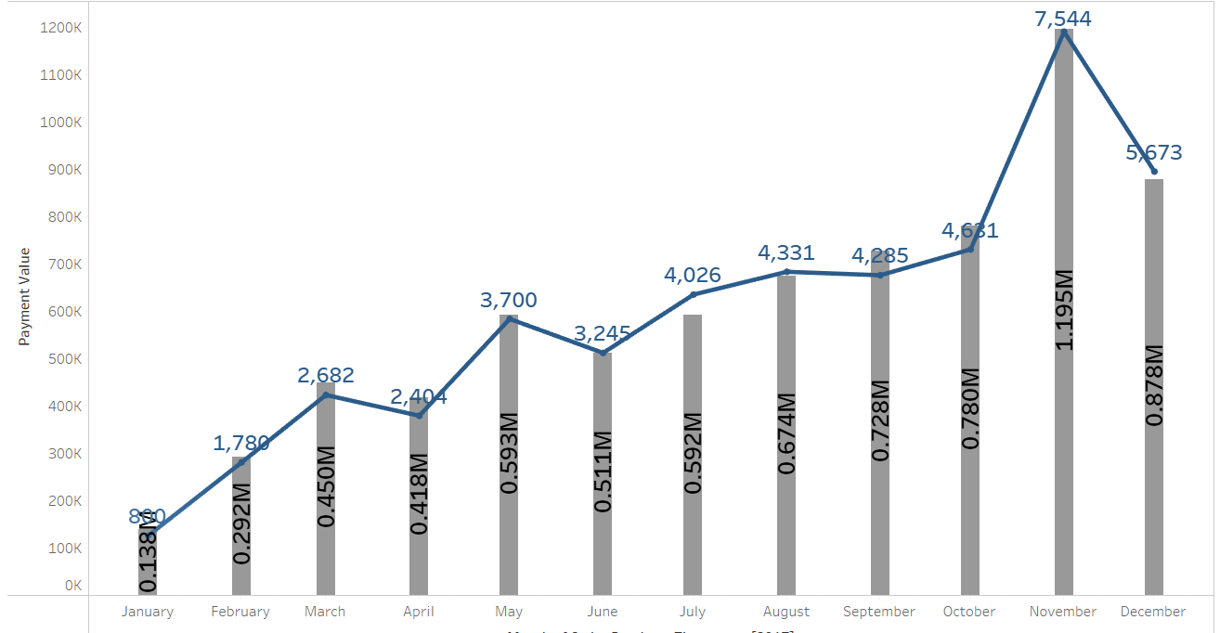
In Year 2017 the orders were corelated with the revenue and was stable from January to October with growth rate of 3.28% where as there was an growth of 7.28% from October to November and the year closed with drop of 18.71% from November to December

Slide 10
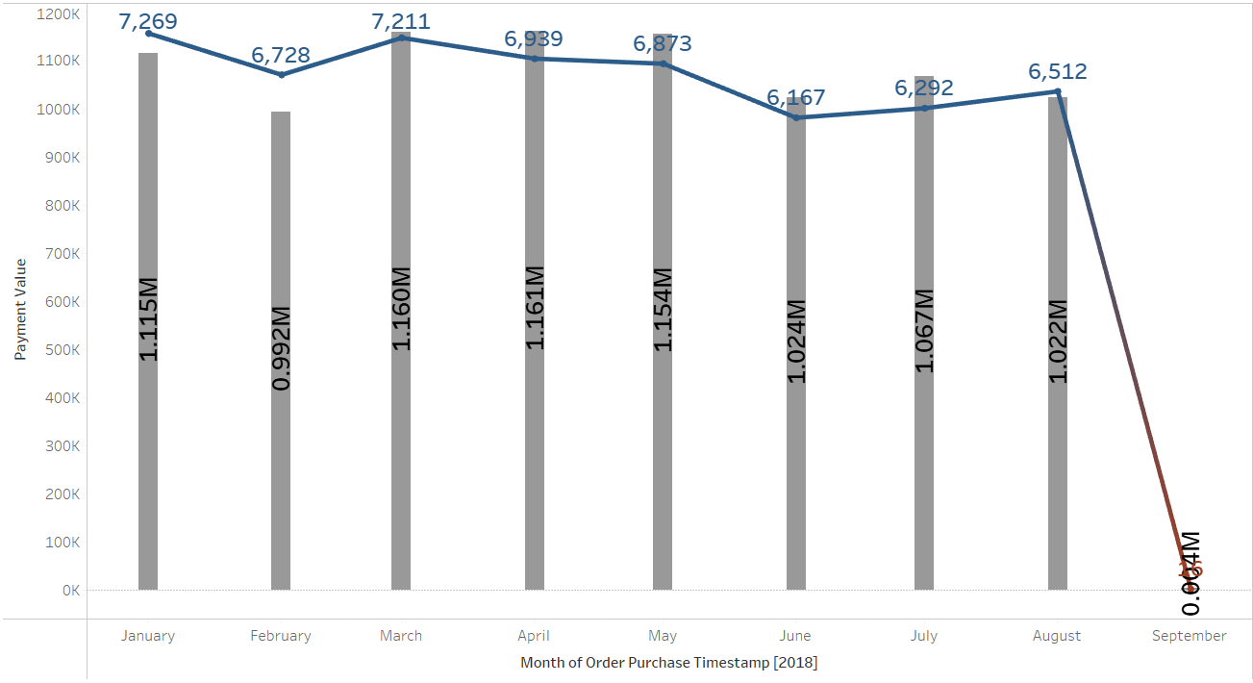
In 2018
Q1order growth was by 3.12% which gave revenue growth by 2.71%
Q2 order slightly declined by 2.04% which effected revenue by 1.25%
Q3 AMJ order slightly declined by 2.04% which effected revenue by 1.25%
Q4 order slightly declined by 1.21% which effected revenue by 0.05%.

Slide 11

Recommendations
The shift from “Bed Bath Table” to “Health Beauty” as the top sales category from 2017 to 2018 indicates a change in consumer preferences. We should adapt our product offerings and marketing strategies to cater to these evolving preferences.
Shift in Consumer Preferences
Sales consistently peaked in November for both 2017 and 2018, suggesting a strong seasonal trend likely tied to holiday shopping. We should stock and advertise seasonal products to maximize sales when demand is high.
Seasonal Sales Trends
The stagnation of sales growth from September to December in 2018, despite a significant increase in order volume earlier in the year, suggests potential issues with inventory management or fulfillment. We should investigate this further to prevent future sales declines during this period.
Sales Growth Stagnation
The decline in order growth and revenue in Q2 and Q3 of 2018 indicates potential challenges during these periods. We should analyze the products that are in high demand during low-sales months and market them effectively.
Quarterly Performance
The overall sales growth across all categories from 2017 to 2018, along with the success of categories like “Health Beauty” and “Watches Gifts”, suggests opportunities for further growth. We should invest in these successful categories and replicate their effective strategies across other categories.
Opportunities for Growth

Slide 12
Thank You
Group 2
Mr. Navin Sanjay Sarwal
Mr. Mohd Shahjeb Shaikh
Mr. GOWTHAM S
Mr. Moksh Avi Singh
Ashish Mahendra Sawant
Mohammad Wasim Shaikh

